Slide 1

Learning Transportation Modeling using Case Studies, GMNS standard, Open-Source AMS Tools
Developed through an early FHWA project: Effective Integration of Analysis, Modeling, and Simulation Tools
AMS DATA HUB CONCEPT OF OPERATIONS:
https://www.fhwa.dot.gov/publications/research/operations/13036/004.cfm
General Modeling Network Specification (GMNS): https://github.com/zephyr-data-specs/GMNS
Xuesong (Simon) Zhou (xzhou74@asu.edu)
https://github.com/xzhou99
School of Sustainable Engineering and the Built Environment
Arizona State University

Slide 2


Inclusive Excellence
https://inclusion.asu.edu/

Slide 3
Outline
1. Motivation
2. Integrated Modeling
3. Datahub
4. Connections to transportation Analaysis, Modeling and Simulation (AMS)
5. Large scale applications

Slide 4
1. Motivations
Adopting open network standard of GMNS
General Travel Network Format Specification is a product of Zephyr Foundation, which aims to advance the field through flexible and efficient support, education, guidance, encouragement, and incubation. Further details can be found in https://zephyrtransport.org/projects/2-network-standard-and-tools/
Integrated graphic user interface and analysis package
(1) Provide an open-source code base to enable transportation researchers and software developers to expand its range of capabilities to various traffic management application.
(2) Present results to other users by visualizing time-varying traffic flow dynamics and traveler route choice behavior in an integrated environment.
(3) Provide a free, educational tool for students to understand the complex decision-making process in transportation planning and optimization processes.

Slide 5
1. Motivations
Our goals
Simplified data input from static traffic assignment
Use parallel computing capability, simplified routing and simulation
Open-source
Existing technical barriers: (based on DTA user survey, TRB network modeling committee, 2009)
Require too many input data: 47%
Take too long to run: 35%
Model is unclear: 35%
Visualization: Seeing is believing
Excel Tools: Start from basics

Slide 6
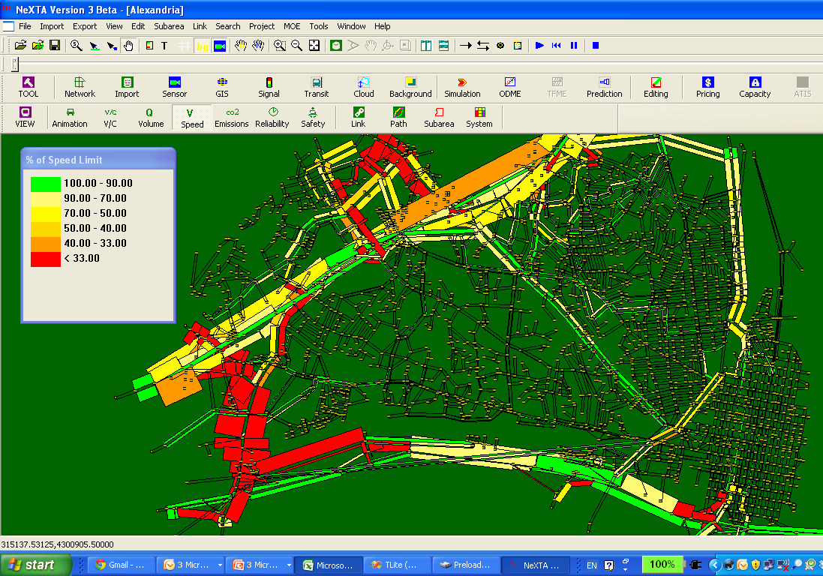
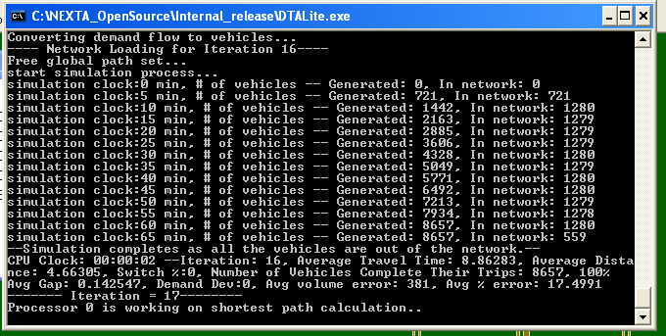
Open-source Free Software Package
NEXTA: front-end Graphical User Interface GUI (C++)
https://github.com/xzhou99/NeXTA-GMNS
DTALite: Open-source computational engine (C++)
STALite: Simulation-based mesoscopic dynamic traffic assignment
https://github.com/xzhou99/stalite-dtalite_software_release
Light-weight and agent-based DTA
Simplified kinematic wave model (Newell)
Built-in OD demand matrix estimation (ODME) program
Emission prediction (light-weight MOVES interface)
Simplified car follow modeling (Newell)

Slide 7
2. Integrated Modeling Practices
Current Practice Ad Hoc
Field Data
Safety
Emissions
Micro-simulation & HCM Analysis
Dynamic Traffic Assignment
Travel Demand Forecasting
Data Hub

Slide 8
Our Vision
With Analysis, Modeling and Simulation (AMS) Data Hub Systematic
Current Practice Ad Hoc
Field Data
Optimizing scheduling and routing, Safety & Emissions Models
HCM & Signal Timing Models
Micro-simulation Models
Dynamic Traffic Assignment Models
Travel Demand Forecasting Models
Data Hub
Big Data
Multimodel Optimization
&
Scheduling and Routing
Highway Capacity & Signal Timing Models
Micro-simulation Models
Traffic Stream Model &Dynamic Assignment Models
Travel Demand Forecasting Models
AMS Data Hub

Slide 9
Our Vision
With AMS Data Hub Systematic
Big Data
Multimodel Optimization
&
Scheduling and Routing
Highway Capacity & Signal Timing Models
Micro-simulation Models
Traffic Stream Model &Dynamic Assignment Models
Travel Demand Forecasting Models
AMS Data Hub

Slide 10
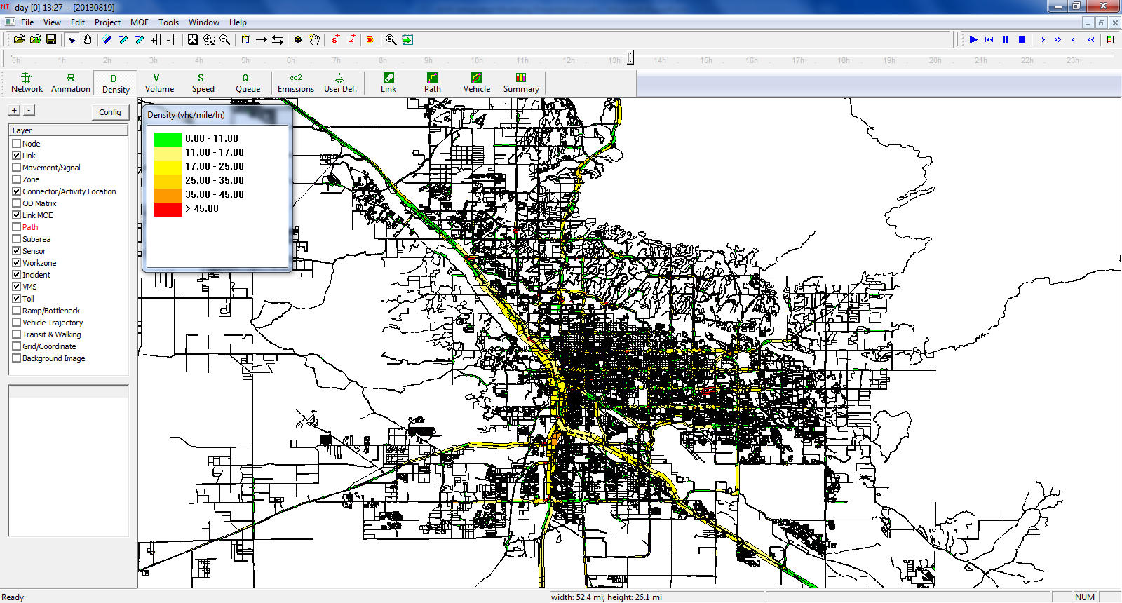
3. AMS Data Hub Software Prototype: NeXTA
Start with GIS with multiple transportation layers
1. node,
2. link,
3. agent,
4. trajectory,
5. signal timing.
Focus on data processing and visualization

Slide 11
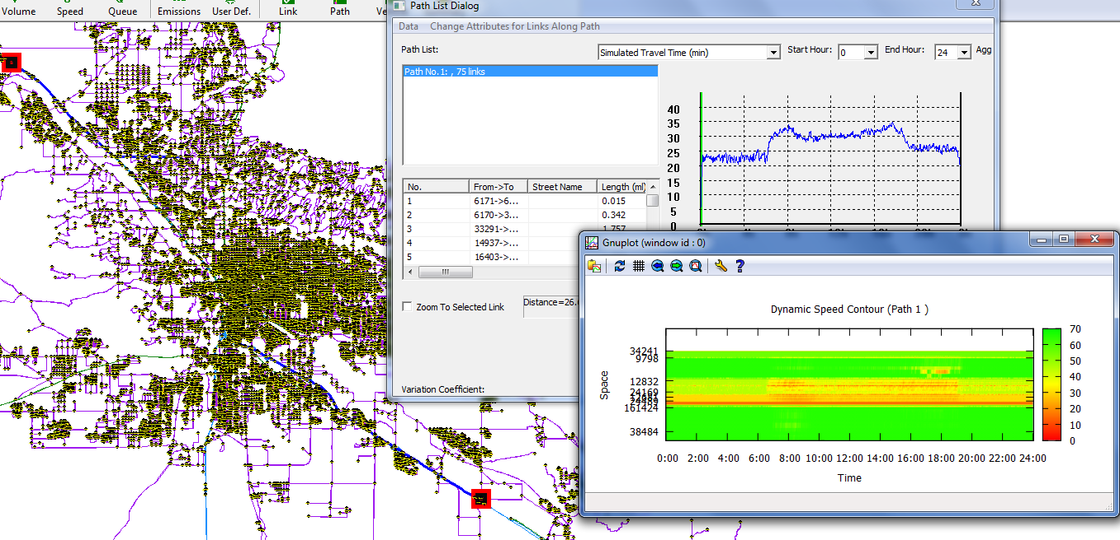
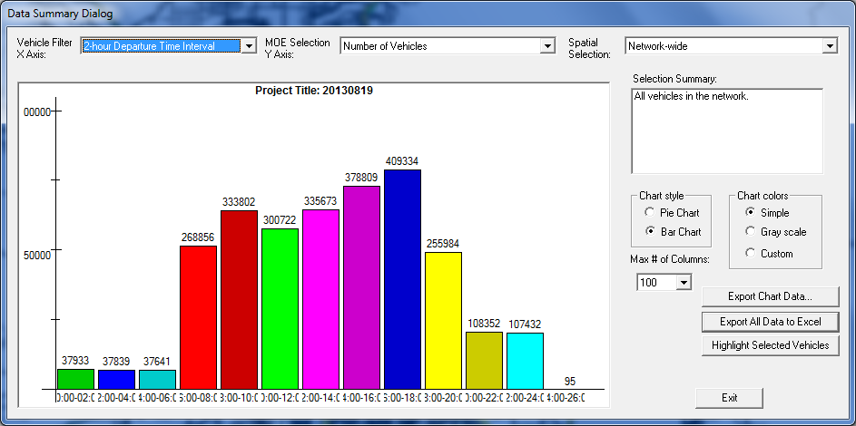
Sample data set: Pasadena Test Data Sets
https://its.dot.gov/data/
https://datahub.transportation.gov/Automobiles/Pasadena-Test-Data-Sets/xig6-cb63
24-hour Simulation Results
2.6 Million Vehicles, 6 GB of data
Users can select any path to generate corridor level performance

Slide 12
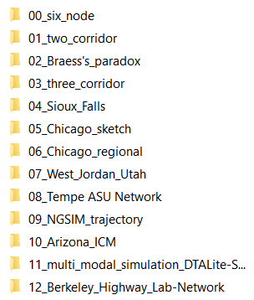
Sample data sets

Slide 13
Data hub 0: Network
Based on GMNS data format
node, link, movement
https://github.com/zephyr-data-specs/GMNS
Regional planning models through GIS shape files
TransCAD
CUBE
VISUM
Export network to GIS
Subarea cut utility
Micro-simulation Models
Traffic Stream Model &Dynamic Assignment Models
Travel Demand Forecasting Models
AMS Data Hub
Highway Capacity & Signal Timing Models
Multimodel Optimization&
Scheduling and Routing
Big Data

Slide 14
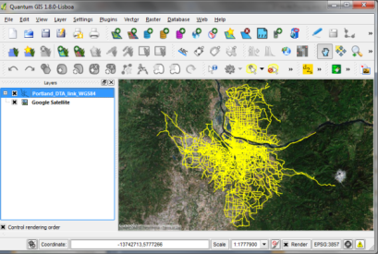
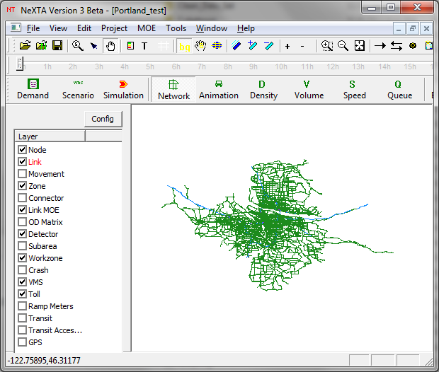
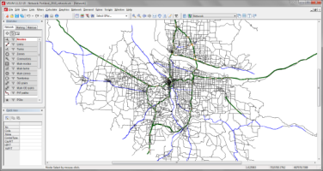
Approach 1: Network Data GIS shape file Importing
Import GIS node/link/zone shape files
Utilize Open-source Geospatial Data Abstraction Library (GDAL) library
https://github.com/xzhou99/NeXTA-GMNS/tree/master/tools/GIS_shape_file_CSV_file_conversion
Cube/TransCAD/VISUM
Open-Source Q-GIS

Slide 15
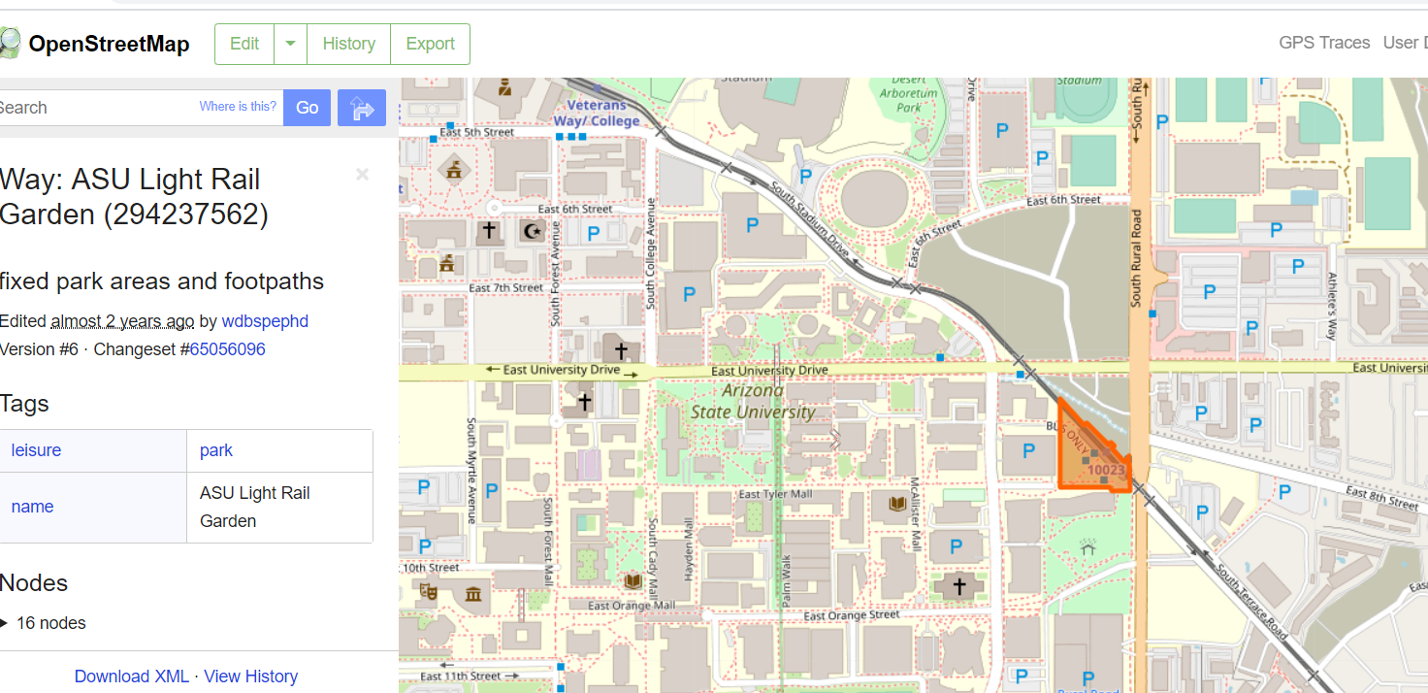
Approach 2: Openstreet Map Data Importing
Import node/link/zone shape to GMNS https://github.com/jiawei92/OSM2GMNS
Openstreet Map
OSM2GMNS tool

Slide 16
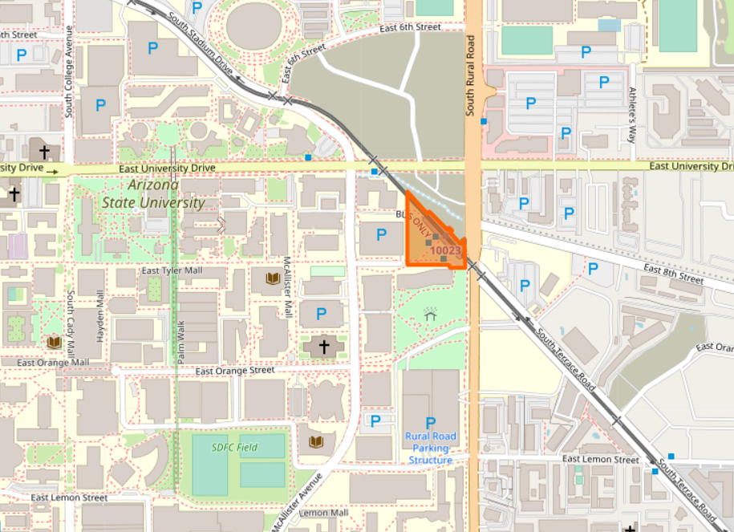
Approach 3: Create network from the scratch based on background image
Import node/link to GMNS data format
background image as image.bmp
draw nodes and links

Slide 17
Approach 4: General Transit Feed Specification (GTFS)
Import GTFS to node/link data to GMNS data format (NeXTA-> menu -> import GTFS)
background image as image.bmp
draw nodes and links

Slide 18
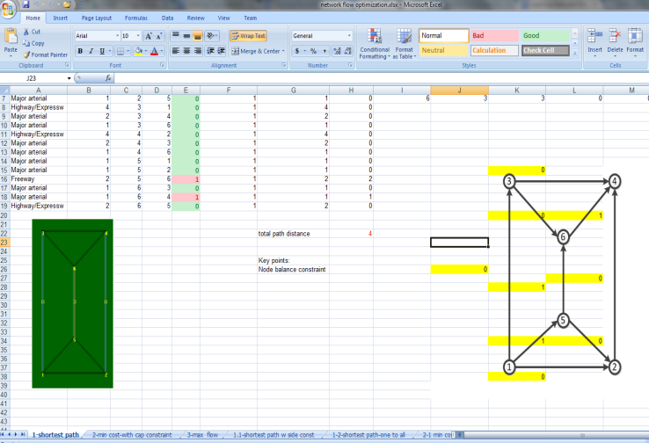
Use of network data: Shortest Path Finding, Network Flow Model
https://github.com/xzhou99/learning-transportation/blob/master/GAMS_code%20-space-time-network/Assignment_2_LearningNetworkFlowOptimizationinExcelandGLPKSolvers.docx

Slide 19
Connection 1: Big Data
Big Data
Multimodel Optimization
&
Scheduling and Routing
Highway Capacity & Signal Timing Models
Micro-simulation Models
Traffic Stream Model &Dynamic Assignment Models
Travel Demand Forecasting Models
AMS Data Hub
Sensor data (link_performance.csv)
15-min speed or count
GPS trajectory data (trajectory.csv)
NGSIM trajectory data set
https://github.com/xzhou99/NeXTA_4_NGSIM_Trajectory_Visualization
BHL sensor data set
I-405 data set from PeMS (to do)

Slide 20
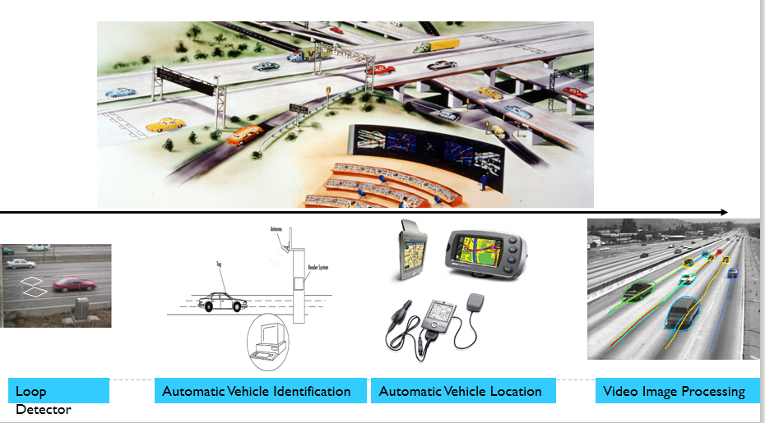
Big data for integrated traffic management

Slide 21
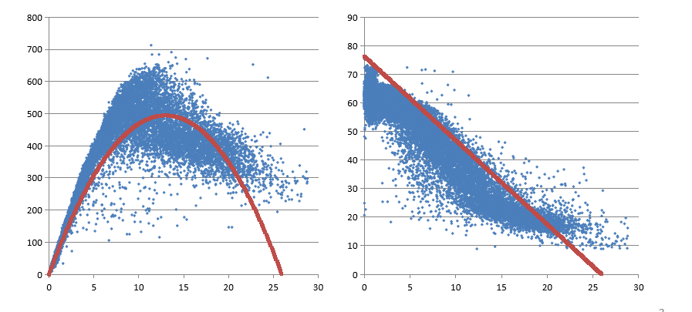
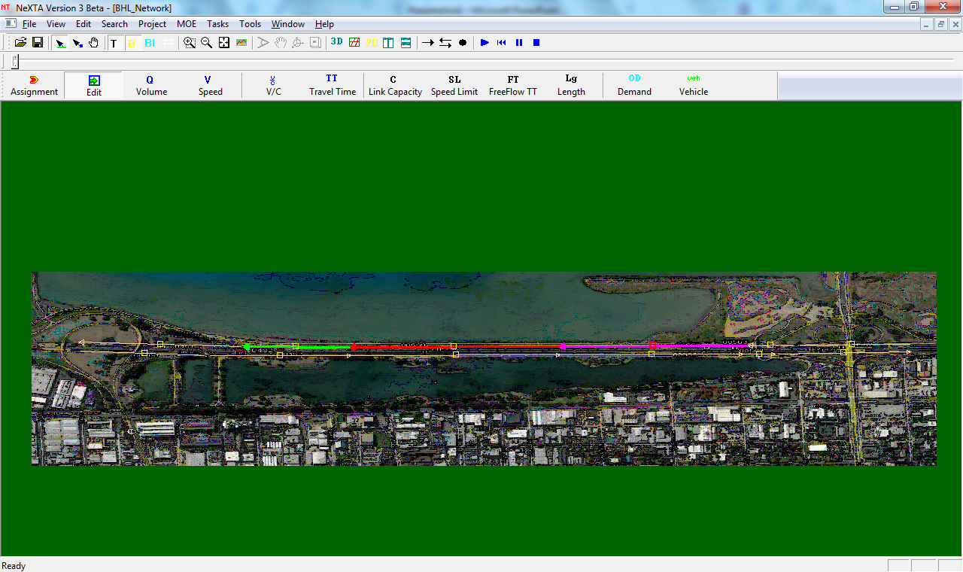
1.1 Understand QKV relationship from aggregated sensor data
Berkeley Highway Laboratory (BHL) sensor data set
https://github.com/xzhou99/stalite-dtalite_software_release/tree/gh-pages/learning_document/4_highway_capacity_traffic_stream_model/BHL-Network

Slide 22
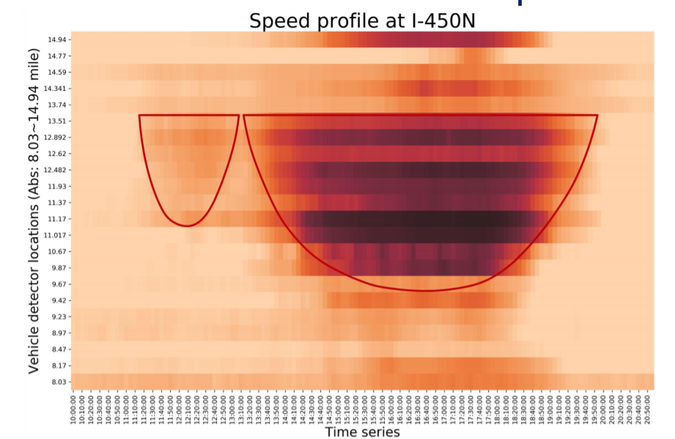
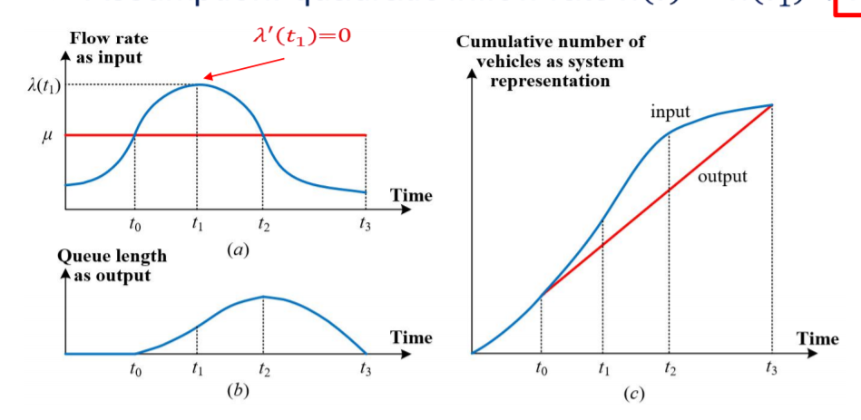
1.2 Understand capacity and bottleneck
https://github.com/xzhou99/stalite-dtalite_software_release/tree/gh-pages/learning_document/4_highway_capacity_traffic_stream_model

Slide 23
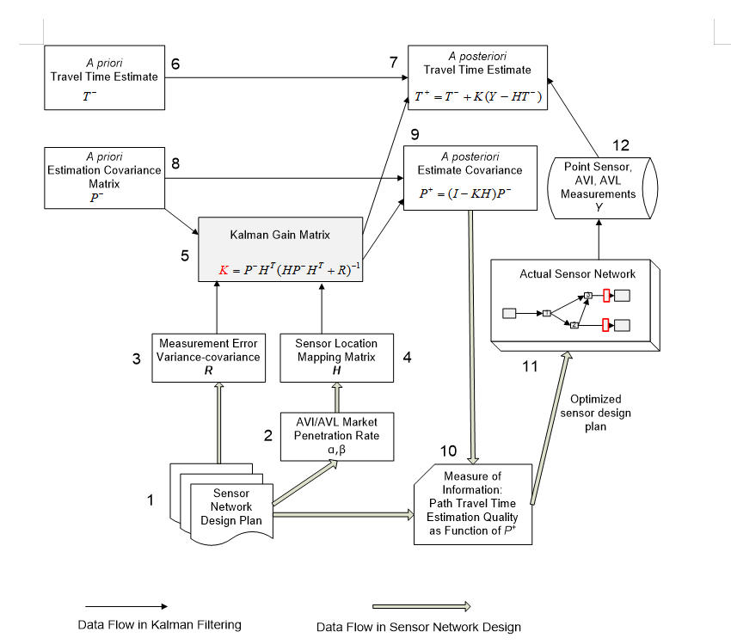
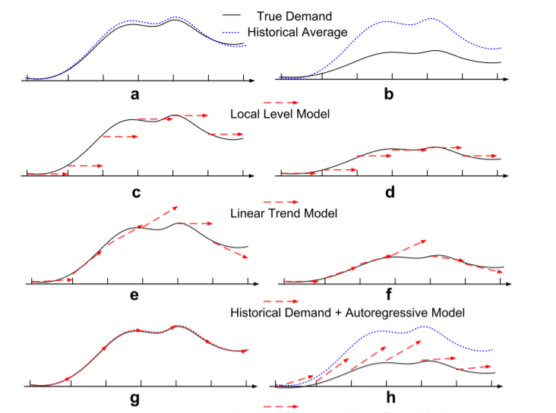
1.3 Understand traffic state estimation and prediction
https://github.com/xzhou99/stalite-dtalite_software_release/tree/gh-pages/learning_document/4_highway_capacity_traffic_stream_model/Learning_KalmanFiltering_for_travel_state_estimation_prediction

Slide 24
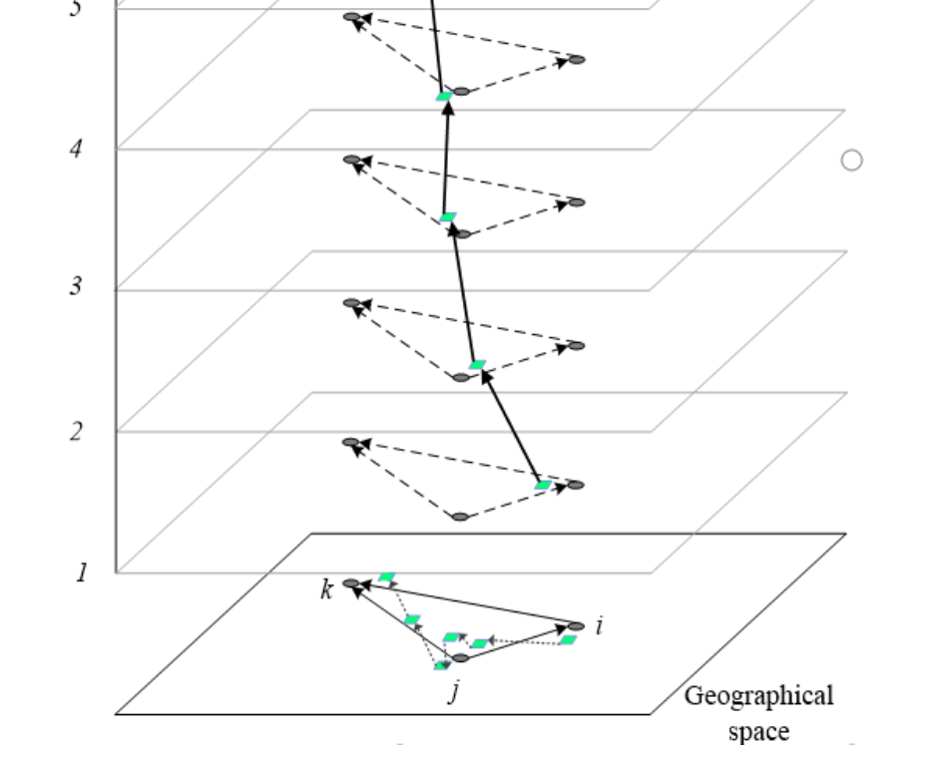
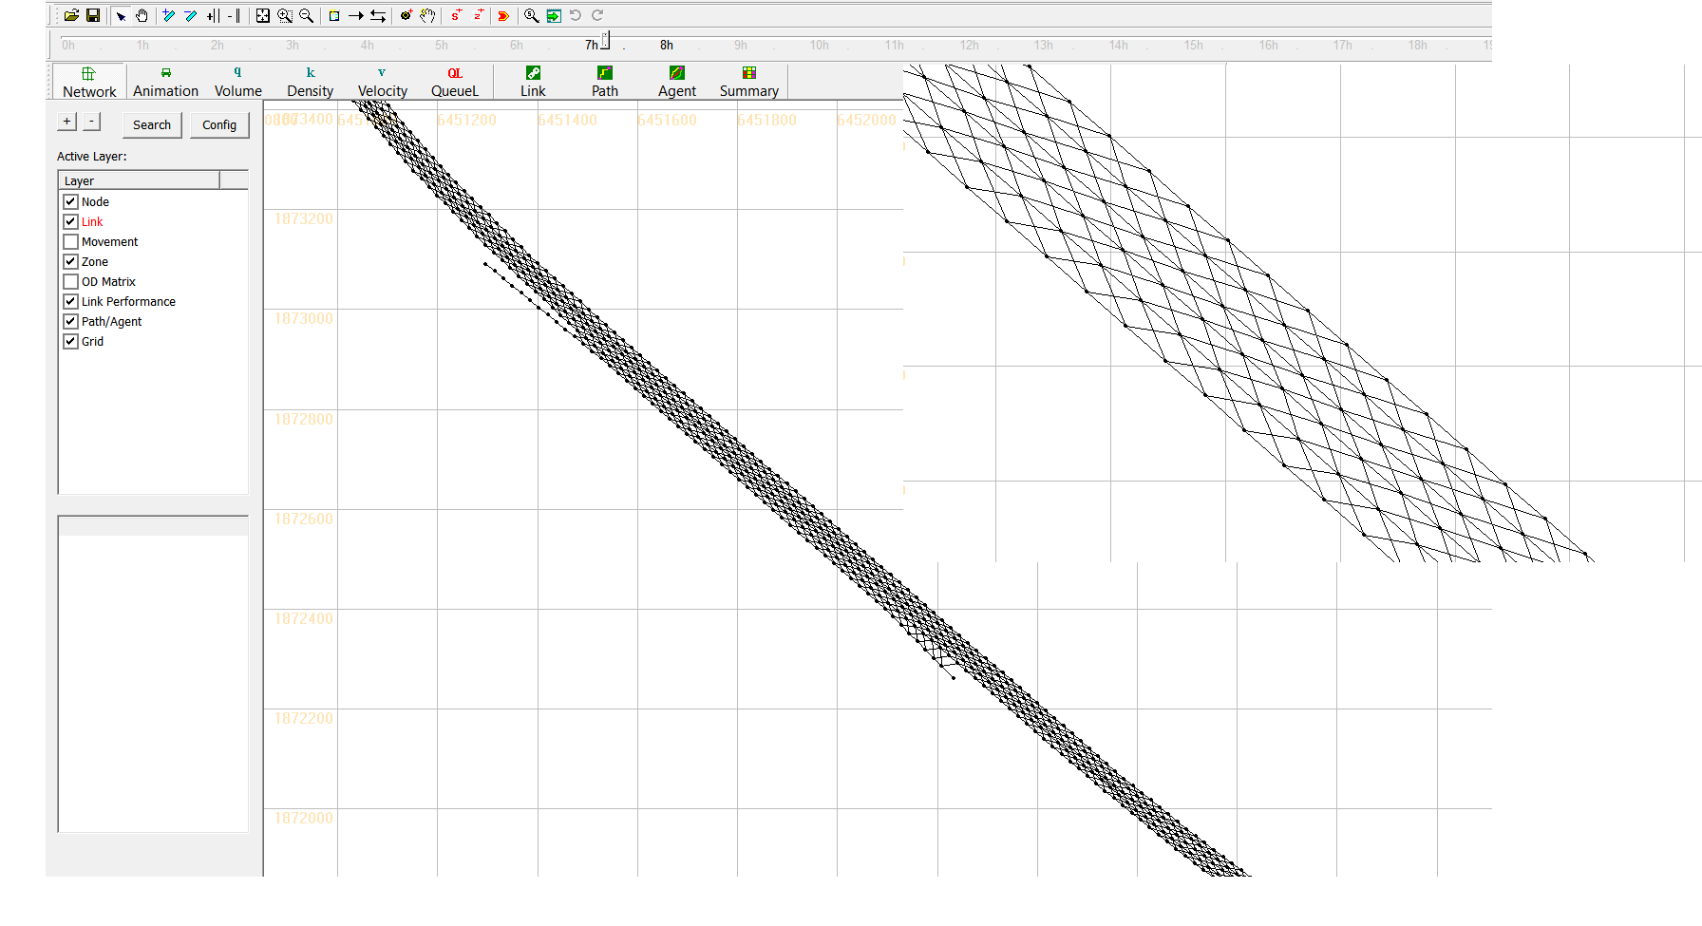
1.4 Map matching based on space-time paths and a time geographic method
https://github.com/xzhou99/space-time-network-based-map-matching

Slide 25
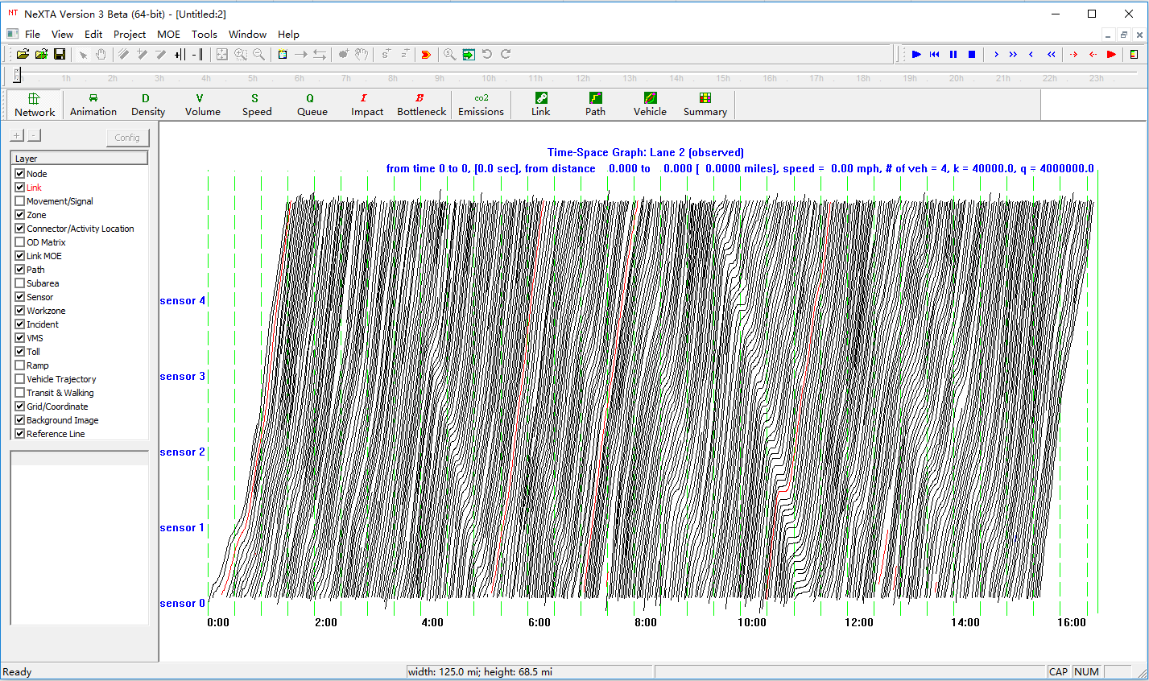
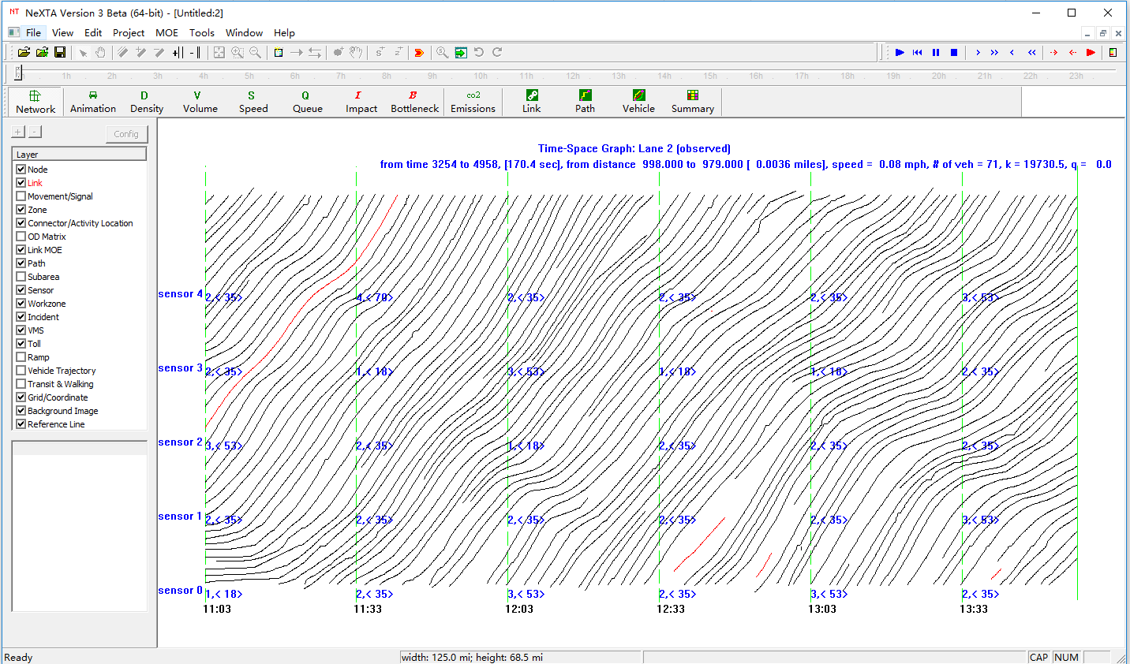
1.5 Analysis of Trajectories from NGSIM

Slide 26
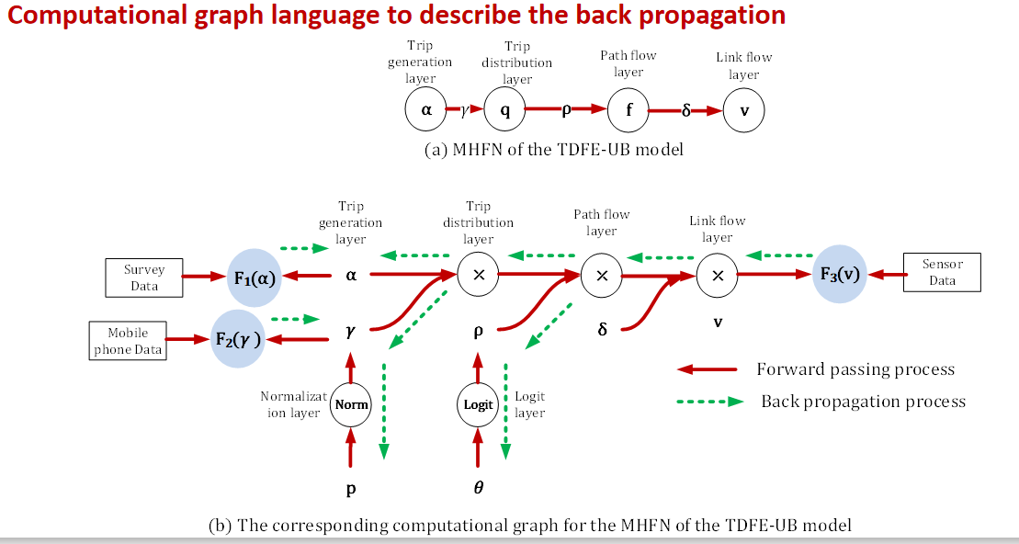
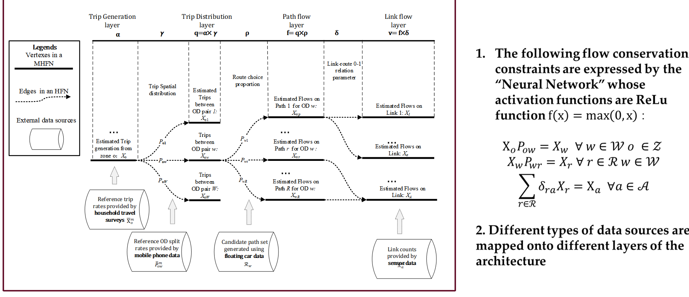
1.6 Integrate deep learning methods with transportation modeling
https://github.com/xzhou99/TCGLite

Slide 27
Connection 2: Travel demand model
Trip generation, distribution and model choice
Static Traffic Assignment
OD destimation using multiple data sources
Layout and land use
Big Data
Multimodel Optimization
&
Scheduling and Routing
Highway Capacity & Signal Timing Models
Micro-simulation Models
Traffic Stream Model &Dynamic Assignment Models
Travel Demand Forecasting Models
AMS Data Hub

Slide 28
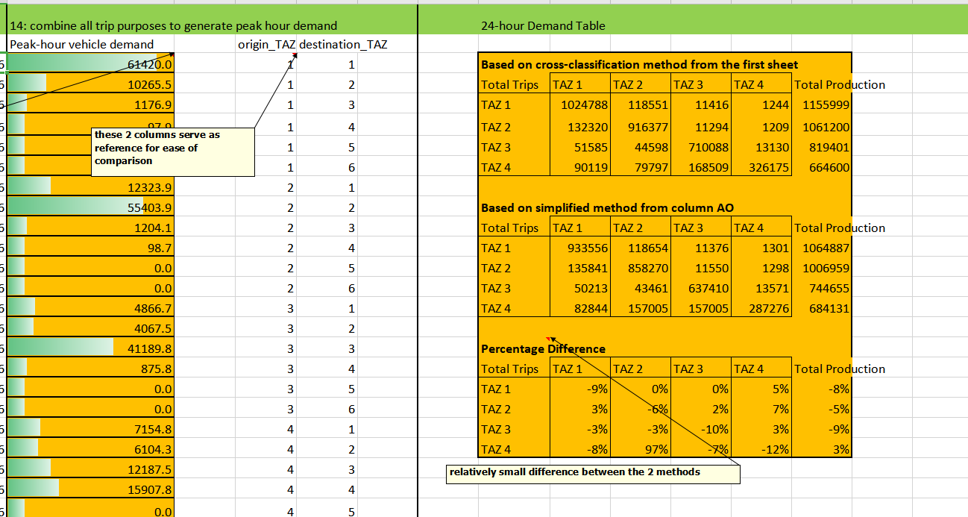
2.1 Trip generation, distribution and model choice
Illustration of 4-steps through Excel Spreadsheet
https://github.com/xzhou99/stalite-dtalite_software_release/tree/gh-pages/learning_document/6_trip_generation
Mode choice model
https://github.com/xzhou99/stalite-dtalite_software_release/tree/gh-pages/learning_document/6_trip_generation/mode_choice

Slide 29
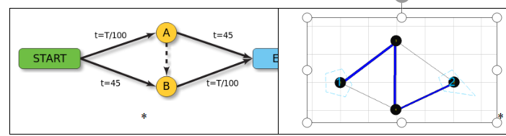
2.2 Static Traffic Assignment
Static traffic assignment GAMS
https://github.com/xzhou99/learning-transportation/tree/master/GAMS_code%20-space-time-network/2%20traffic_assignment
Static traffic assignmetn using STALite
https://github.com/xzhou99/stalite-dtalite_software_release/tree/gh-pages/learning_document/2_static_user_equilibirum

Slide 30
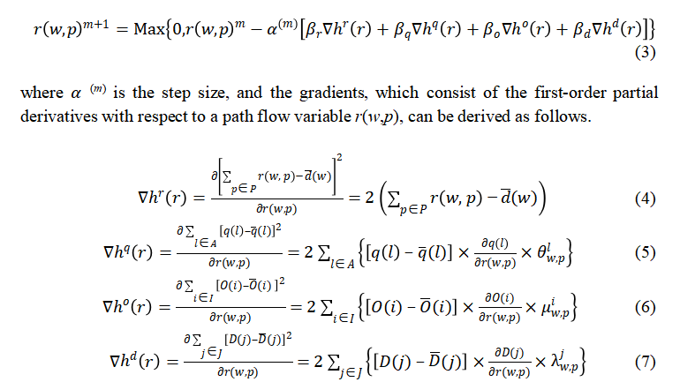
2.3 OD Demand Estimation
Static OD demand estimation using STAlite
https ://github.com/xzhou99/stalite-dtalite_software_release/tree/gh-pages/learning_document/7_ODdemand_estimation
ODME using GAMS
https ://github.com/xzhou99/ODME
Computational graph based demand estimation model using multiple data sources
https://github.com/xzhou99/TCGLite

Slide 31
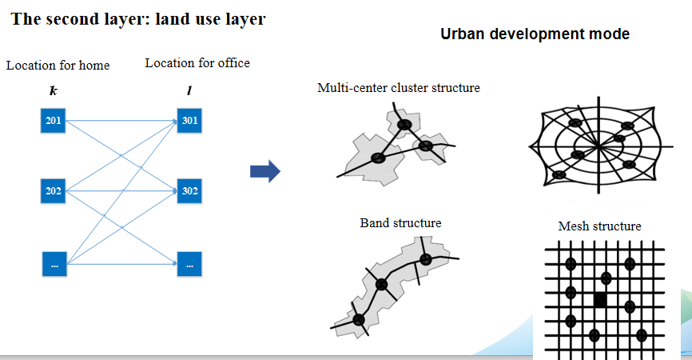
2.4 City, Land Use and Urban Layout
https://github.com/xzhou99/Urban-Layout-QAP

Slide 32
Connection 3: Traffic Stream Model and Dynamic Assignment
Dynamic user equilibrium assignment method
Model queue spillback
Consider traffic flow dynamics
GAMS for dynamic traffic assignment
https://github.com/xzhou99/learning-transportation/tree/master/GAMS_code%20-space-time-network/2%20traffic_assignment
DTALite/STALite
https:// github.com/xzhou99/DTALite-python
https://github.com/xzhou99/stalite-dtalite_software_release
Learning document
https://github.com/xzhou99/stalite-dtalite_software_release/tree/gh-pages/learning_document/3_dynamic_user_equilibrum_and_traffic_bottleneck
Big Data
Multimodel Optimization
&
Scheduling and Routing
Highway Capacity & Signal Timing Models
Micro-simulation Models
Traffic Stream Model &Dynamic Assignment Models
Travel Demand Forecasting Models
AMS Data Hub

Slide 33
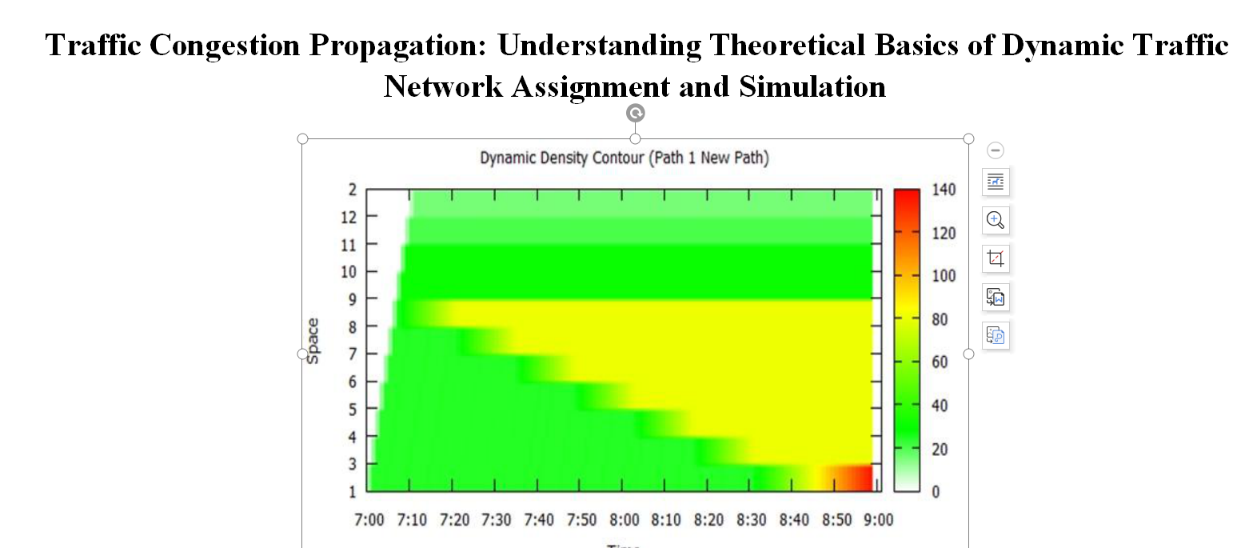
3.1 Traffic flow modeling
https://github.com/xzhou99/stalite-dtalite_software_release/tree/gh-pages/learning_document/3_dynamic_user_equilibrum_and_traffic_bottleneck
BPR travel time functions
Point queue (relaxed storage constraints)
Spatial queue (similar to DYNASMART-P/Dynus-T model)
Newell’s model (similar to Cell Transmission Model)
Shockwave propagation

Slide 34
3.2 Understand Traffic Simulation
Notes:
In general, the traffic simulation assigns vehicles to different paths based upon link travel time. The physical process of moving vehicles works in a two-step process. First, a vehicle is moved across a link during the link pass, and then moved between links at the node during the node pass. Link travel times from the traffic simulator are fed to the shortest path model for path selection. The new paths are then fed back into the traffic simulator in the next iteration.

Slide 35
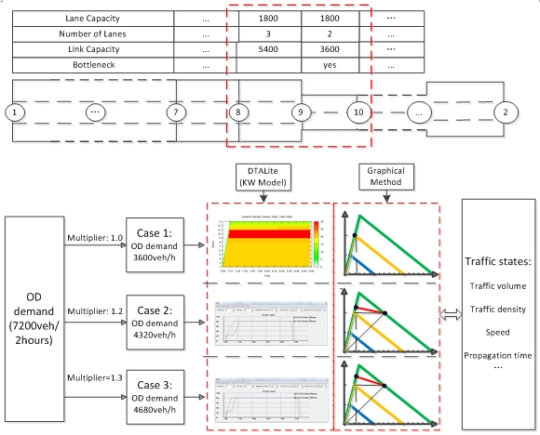
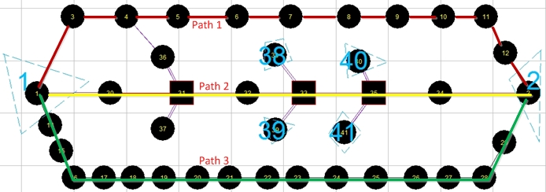
3.3 Understand dynamic traffic equilibrium

Slide 36
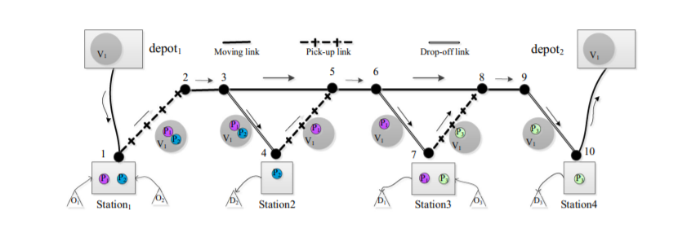
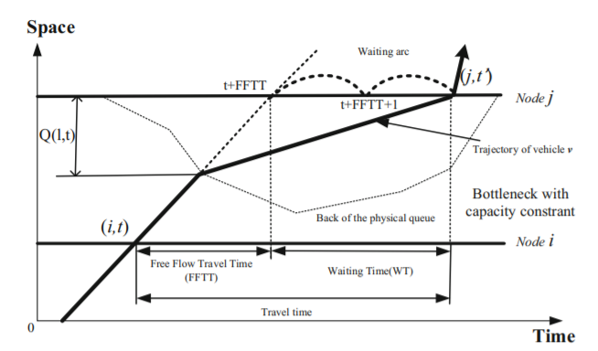
3.4 Public Transportation Mobility Simulation for Bridging Multi-agent Simulation and Optimization
https://github.com/xzhou99/DTALite-S
https://link.springer.com/article/10.1007/s40864-018-0100-x

Slide 37
Connection 4: Microsimulation Models
Big Data
Multimodel Optimization
&
Scheduling and Routing
Highway Capacity & Signal Timing Models
Micro-simulation Models
Traffic Stream Model &Dynamic Assignment Models
Travel Demand Forecasting Models
AMS Data Hub
https://github.com/xzhou99/NeXTA_4_NGSIM_Trajectory_Visualization
Multi-resolution network convertoer: Ocean
https://github.com/jiawei92/Ocean
CAVLite
https://github.com/jiawei92/CAVLite

Slide 38
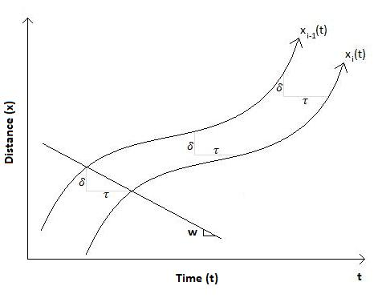
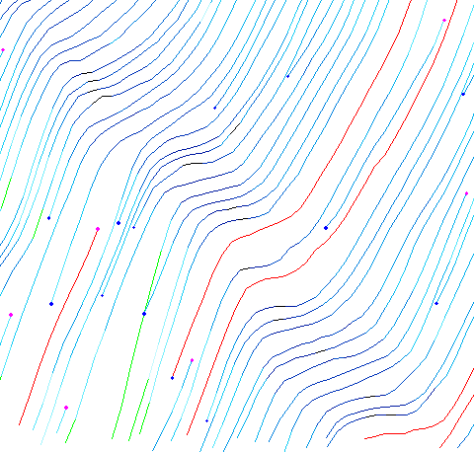
4.1 Understand driving behavior
Underststand microscopic car following model
https://github.com/xzhou99/DTW_Vehicle_Trajectory_Data
https://github.com/xzhou99/Basic_DTW_Matlab
Reaction distance/spacing δ
Reaction time lag τ
W = δ/ τ

Slide 39
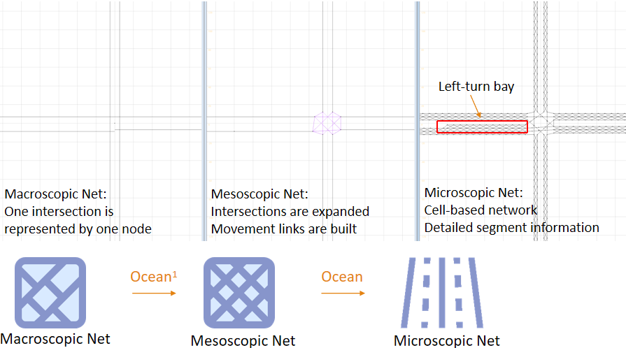
4.2 Building multi-resolution networks
https://github.com/jiawei92/Ocean

Slide 40

4.3 Modeling Signal Control Logic

Slide 41
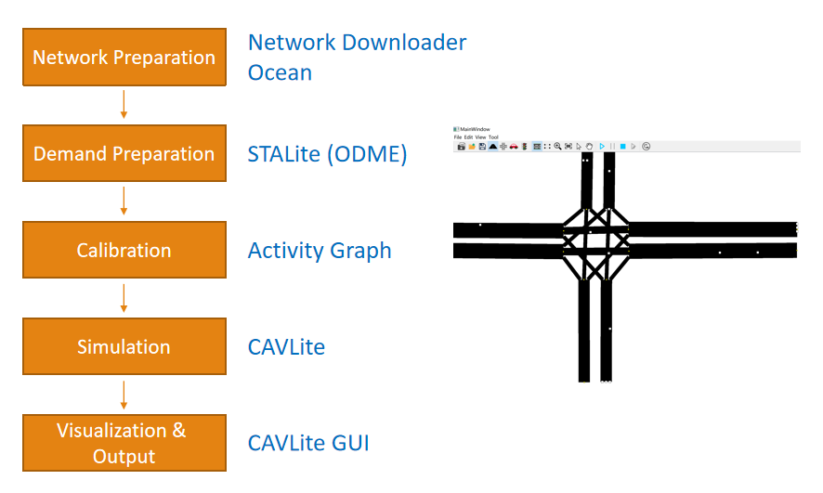
4.4 Multi-resolution Traffic Modeling

Slide 42
Connection 5: Capacity Analysis Tools
Big Data
Multimodel Optimization
&
Scheduling and Routing
Highway Capacity & Signal Timing Models
Micro-simulation Models
Traffic Stream Model &Dynamic Assignment Models
Travel Demand Forecasting Models
AMS Data Hub
HCM-based Quick Estimation Method (QEM)
Given turning volume,
Generate signal phasing and timing data
https://github.com/xzhou99/Sigma-X
https://github.com/xzhou99/SignalAPI
Learning Document for Signal Timing Optimization
https://github.com/xzhou99/stalite-dtalite_software_release/tree/gh-pages/learning_document/5_signal_timing_optimization

Slide 43
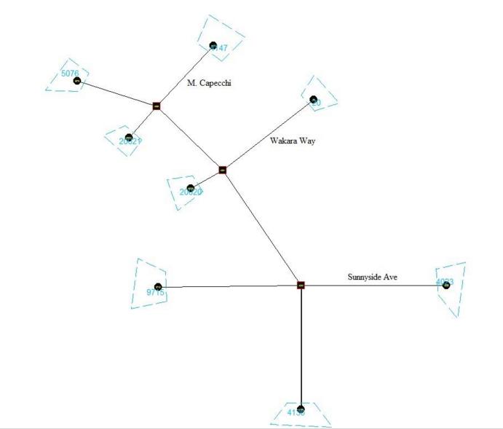
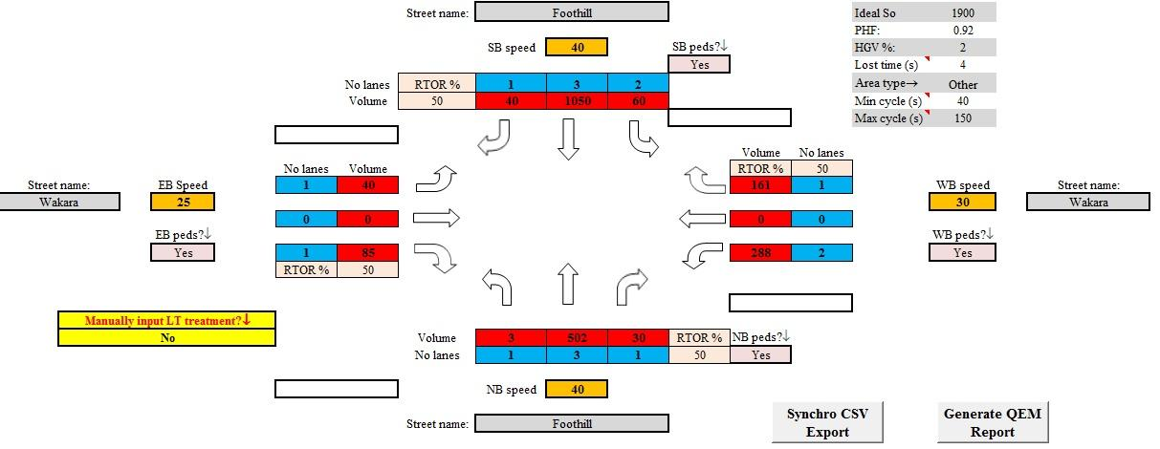
5.1 Traffic signal timing optimization
https://github.com/xzhou99/Sigma-X
https://github.com/xzhou99/SignalAPI

Slide 44
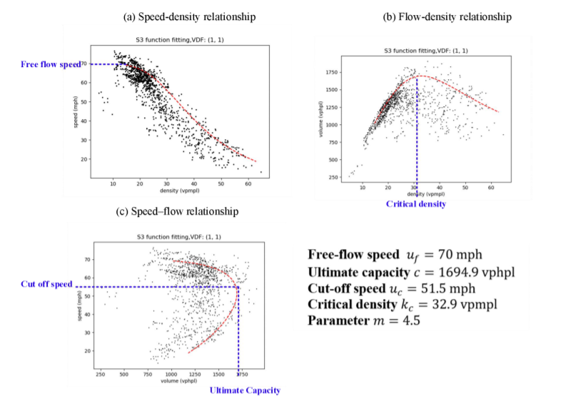
5.2. Freeway capacity analysis
https://github.com/xzhou99/VDF_calibration

Slide 45
Connection 6: Optimization, Routing and Scheduling
Optimization
Transportation problem
Shortest path problem
Space time network design
Transit network design
Yard management
Vehicle routing problem
Train scheduling
Customized bus service design
https://github.com/xzhou99/learning-transportation/tree/master/GAMS_code%20-space-time-network
VRPLite
https://github.com/xzhou99/VRPLite
DTALite-S: for multimodal transportation simulation
https://github.com/xzhou99/DTALite-S
Big Data
Multimodel Optimization
&
Scheduling and Routing
Highway Capacity & Signal Timing Models
Micro-simulation Models
Traffic Stream Model &Dynamic Assignment Models
Travel Demand Forecasting Models
AMS Data Hub

Slide 46
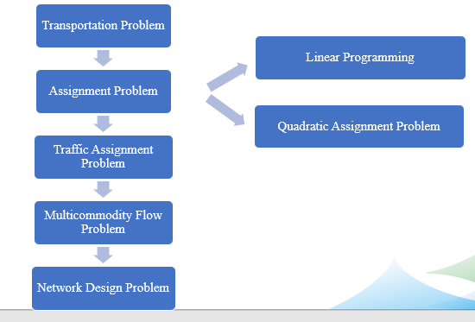
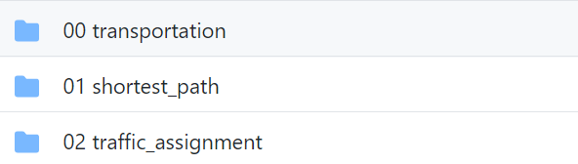
6.1 Learning Nework Flow Models based on GAMS
https://github.com/xzhou99/learning-transportation/tree/master/GAMS_code%20-space-time-network

Slide 47
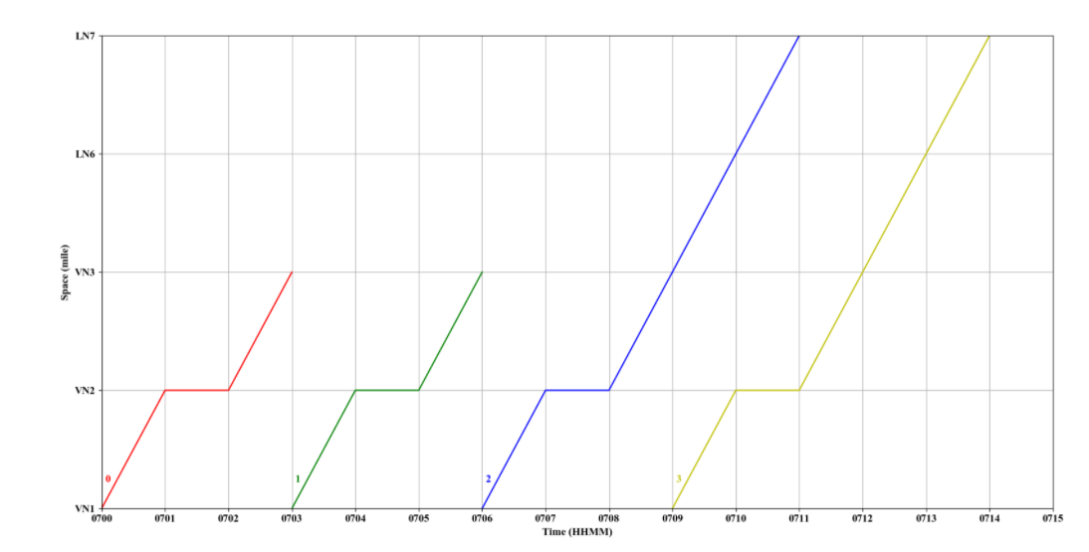
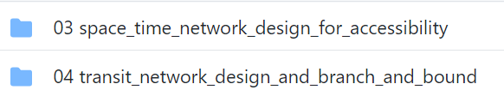
6.2 From space-time diagram to space-time networks
https://github.com/xzhou99/space-time-diagram_gmns
https://github.com/xzhou99/learning-transportation/tree/master/GAMS_code%20-space-time-network

Slide 48
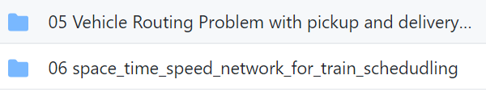
6.3 From space-time network to space-time-state network in vehicle routing
https://github.com/xzhou99/VRPLite
https://link.springer.com/article/10.1007/s40864-018-0083-7
https://github.com/xzhou99/learning-transportation/tree/master/GAMS_code%20-space-time-network

Slide 49
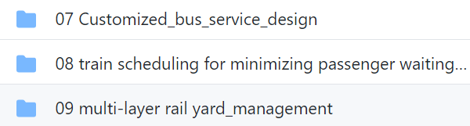
6.4 Use space-time network in multimodal system scheduling
https://github.com/xzhou99/learning-transportation/tree/master/GAMS_code%20-space-time-network

Slide 50
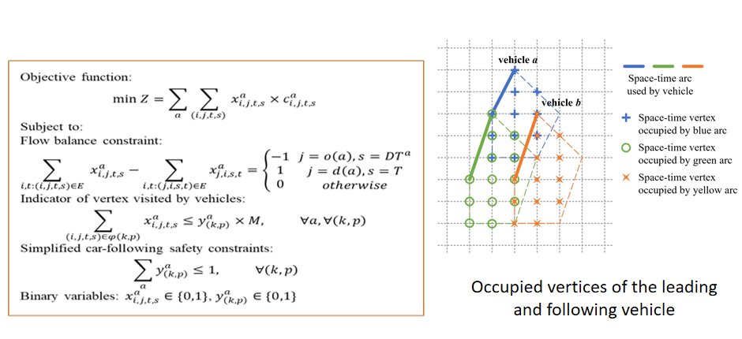
6.5 Automated vehicle scheduling based on space-time networks
https://github.com/xzhou99/learning-transportation/tree/master/GAMS_code%20-space-time-network
https://github.com/xzhou99/AVRLite

Slide 51

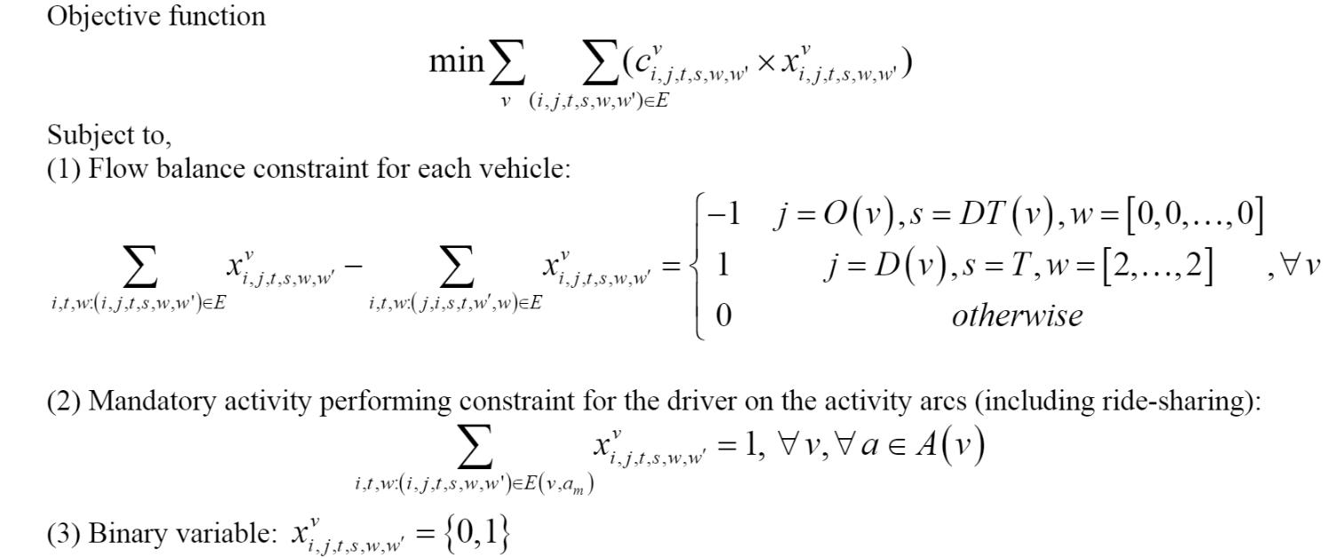
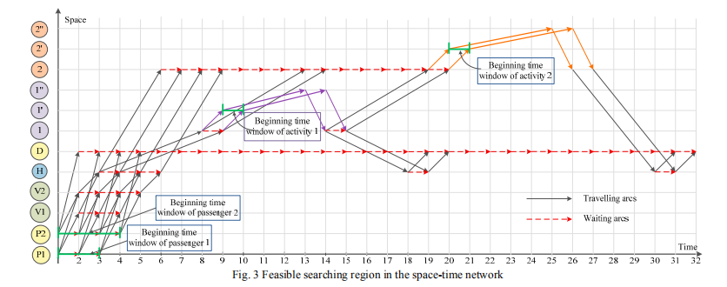
6.6 Travel demand and activity modeling based on space-time-state network
https://github.com/xzhou99/learning-transportation/tree/master/GAMS_code%20-space-time-network

Slide 52
Summary of related open-source tools
Simulation-based mesoscopic dynamic traffic assignment
DTALite(based on simplified kinematic wave model)
Simulation-based mesoscopic dynamic traffic assignment
STALite
visualization interfeace
NEXTA
Traffic state estimation and prediction, Train routing and scheduling
VRPLite

Slide 53
5. Large scale applications

Slide 54


Computational Challenges
Shared memory-based parallel computing for agent-based path finding and mesoscopic traffic simulation (based on OpenMP)
Maryland State-wide model:
20 K nodes, 47K links, 3,000 zones, 18 M agents
CPU time: 30 min per UE iteration on a 20-core workstation with 194 GB RAM

Slide 55

Origin-Destination Demand Spatial Distribution Pattern
Collaboration with University of Maryland and Maryland State Highway Administration
Supported by TRB SHRP II Program

Slide 56

Vehicle Animation at Network Level

Slide 57

Volume at Network Level
Band width of a link is proportional to link volume

Slide 58

Density at Network Level

Slide 59

Speed at Network Level

Slide 60

Queue at Network Level

Slide 61


Queue Duration at Network Level
Link width represents duration of congestion (e.g. 60 min vs. 120 min)

Slide 62

Time-dependent Bottleneck Locations
Size of a circle represents the total delay at one node
Color of a circle represents the age of congestion (to identify the congestion propagation sequence)

Slide 63

Statewide Network Coverage in Google Earth

